Slide 1
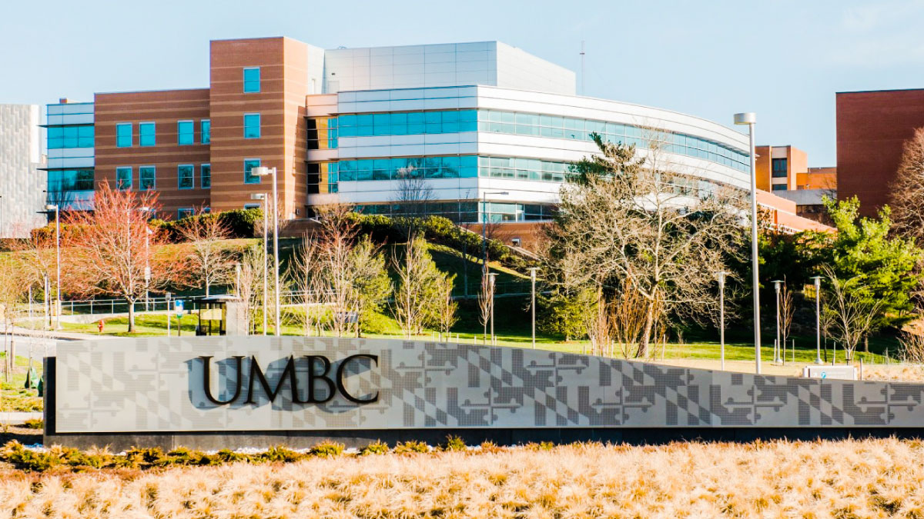
Designing Energy Efficient Neural Networks According to Device Operation Principles
Ergun Simsek
Assistant Professor of Computer Science & Electrical Engineering
Director of Graduate Data Science Programs
simsek@umbc.edu
https://www.csee.umbc.edu/~simsek/

Slide 2
Our Research Interest
Scientific Computing
Optimization
Machine Learning

Slide 3
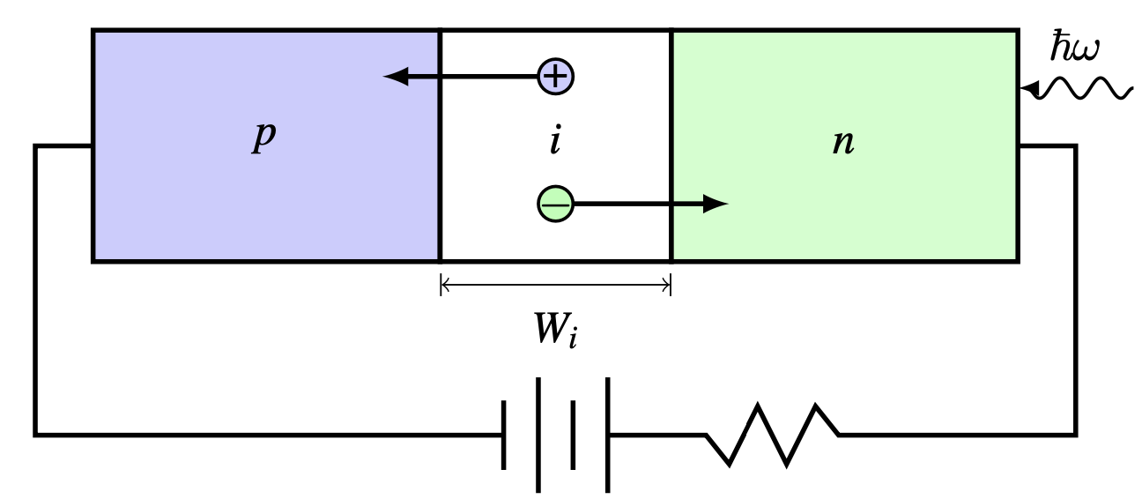
Photodetectors

Slide 4

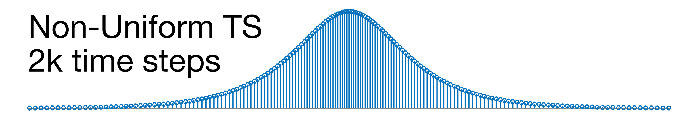
Fast Solvers for Photodetectors (1 of 3)
Simsek et al., NUSOD 2022

Slide 5
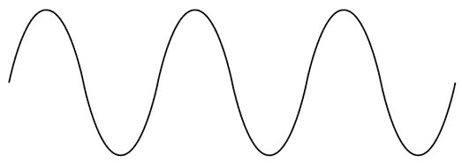
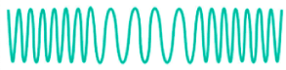
Fast Solvers for Photodetectors (2 of 3)
A
f
A
f
Simsek et al., to appear in IEEE Transactions on Electron Devices

Slide 6
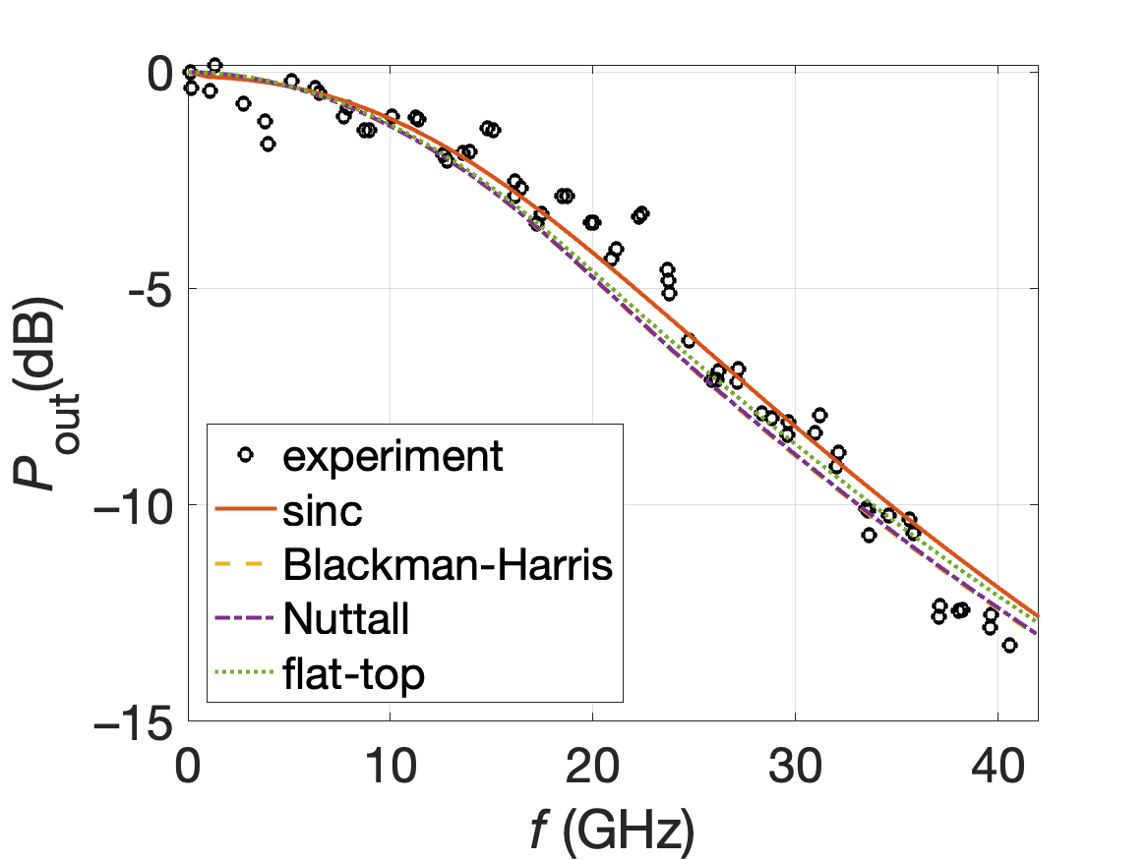

Fast Solvers for Photodetectors (3 of 3)
Simsek et al., to appear in IEEE Transactions on Electron Devices

Slide 7
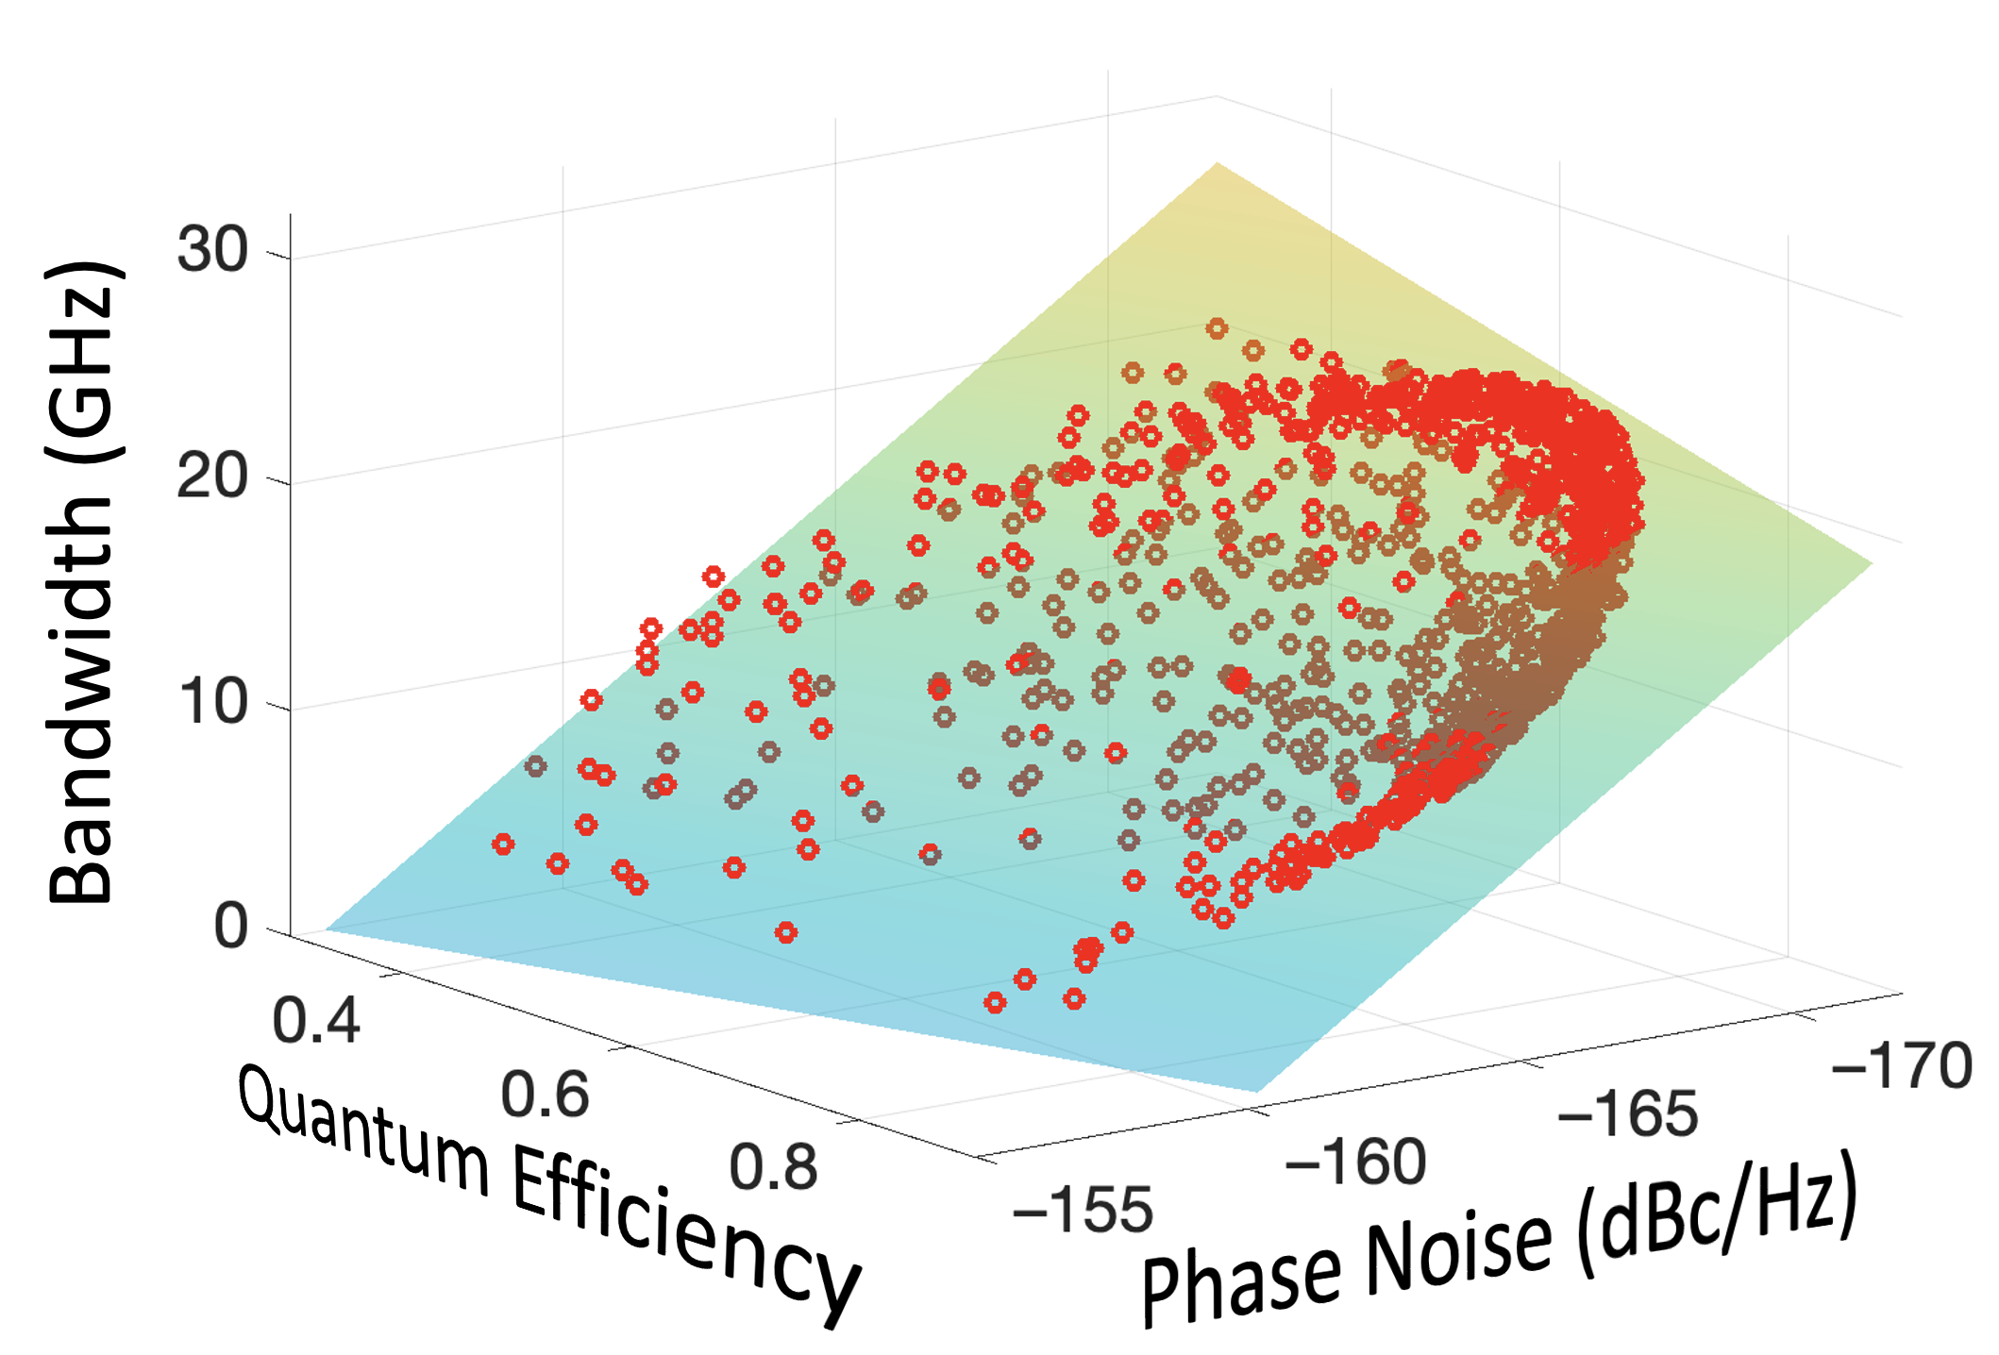
Numerical Optimization
Simsek et al., CLEO Europe 2023
Simsek et al., PIERS 2023

Slide 8
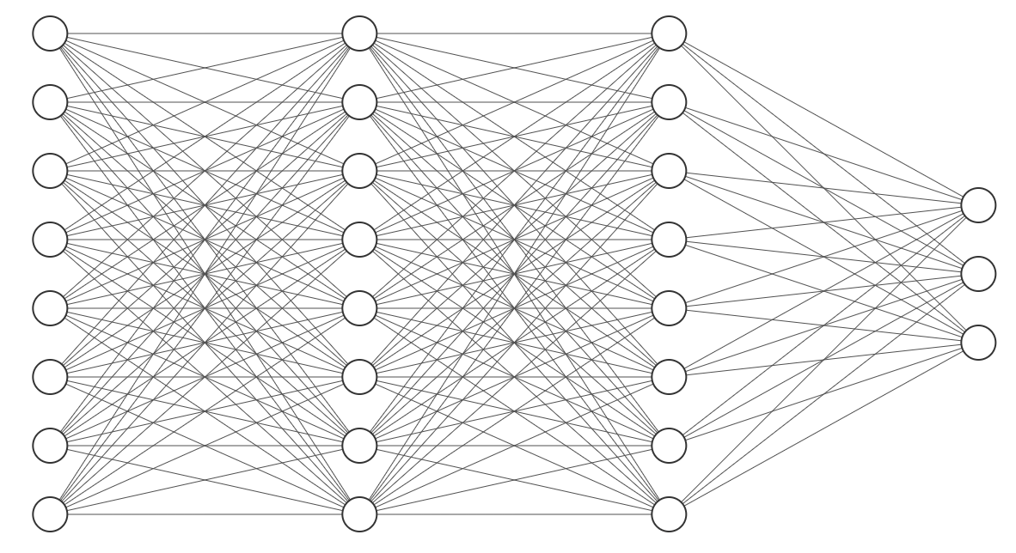
Neural Networks
t₁
d₁
InGaAs, p⁺ (t₁, d₁)
InP, p⁺ (t₂, d₂)
InGaAsP, Q1.1 (t₃, d₃)
t₂
d₂
PN
Q_{eff}
BW
…
t₃
d₃
InP, n⁺ (t₁₅, d₁₅)
InGaAs, n⁺ (t₁₆, d₁₆)
InP, n⁺ (t₁₇, d₁₇)
t₄
d₄
…
…
…
…
Linear Regression | k-Nearest Neigh. | Random-Forests | FCNN
16.81 | 5.48 | 3.5 | 2.88
Max. Error (%):

Slide 9
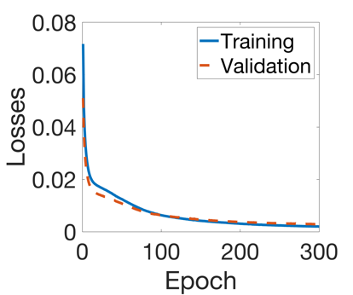
Energy Efficient Neural Networks!
Pairing
Neighboring
Interfacing
Ordering
InGaAs, p⁺ (t₁, d₁)
InP, p⁺ (t₂, d₂)
InGaAsP, Q1.1 (t₃, d₃)
t₁
d₁
Max Error < 0.8%
Regressing
t₂
d₂
PN
Q_{eff}
BW
…
t₃
d₃
InP, n⁺ (t₁₅, d₁₅)
InGaAs, n⁺ (t₁₆, d₁₆)
InP, n⁺ (t₁₇, d₁₇)
t₄
d₄
…
…
…
…
…

Slide 10
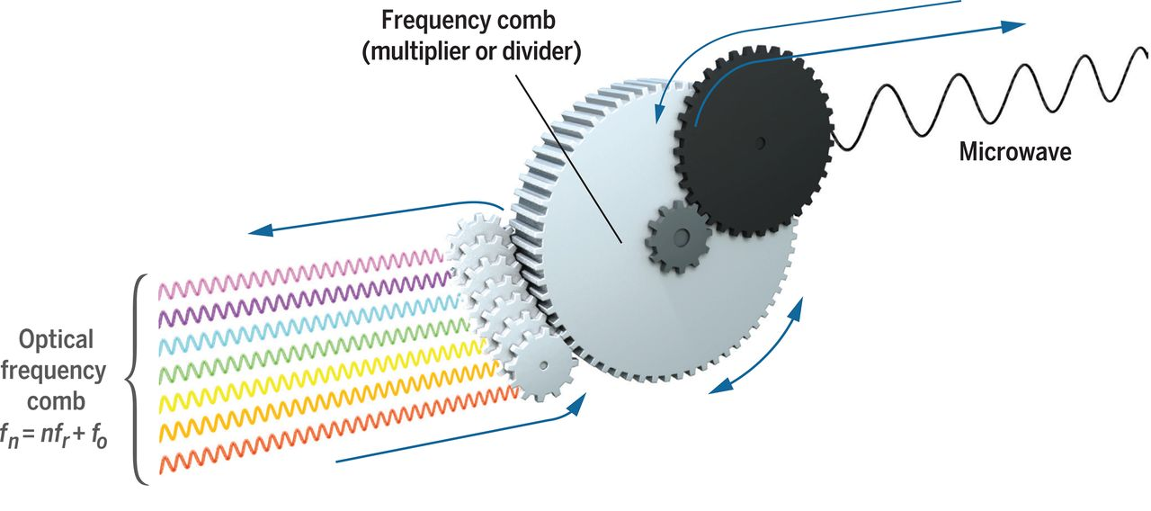
Frequency Combs
Science, 369, 6501

Slide 11
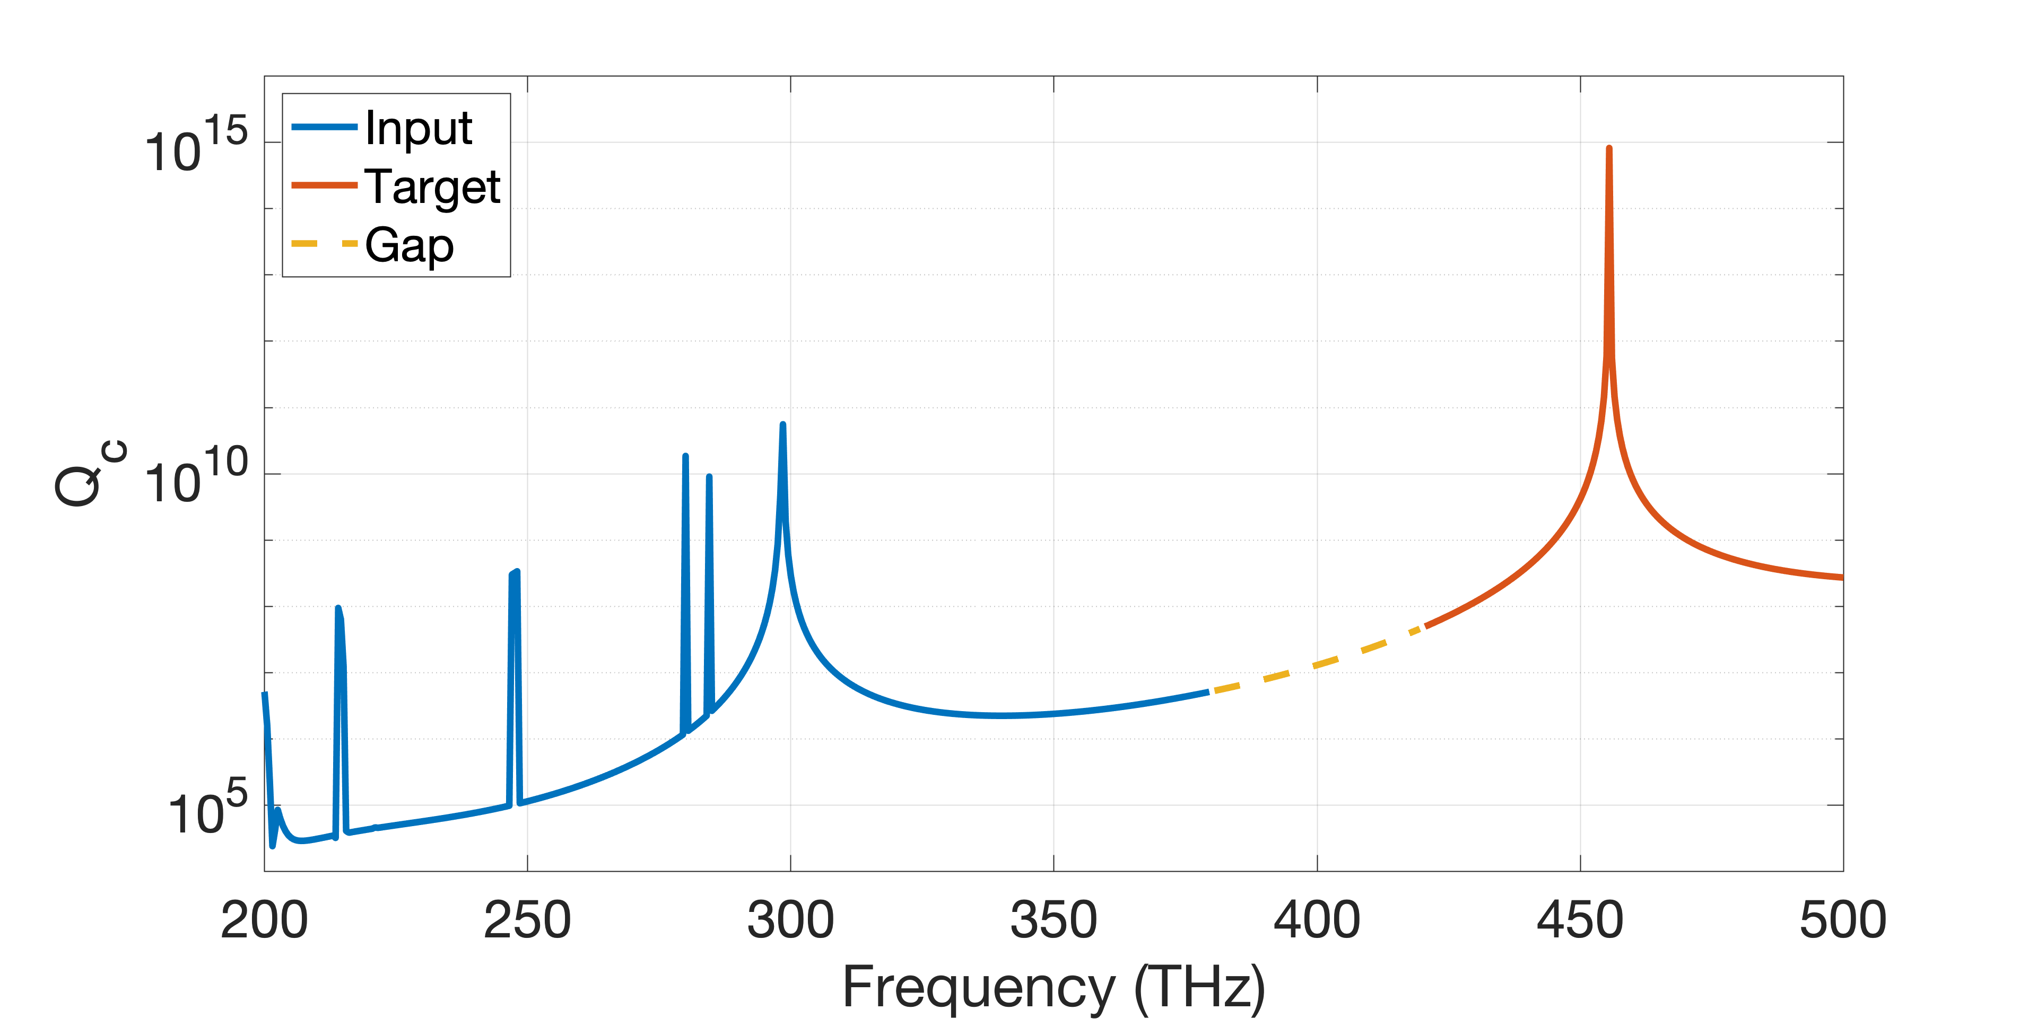
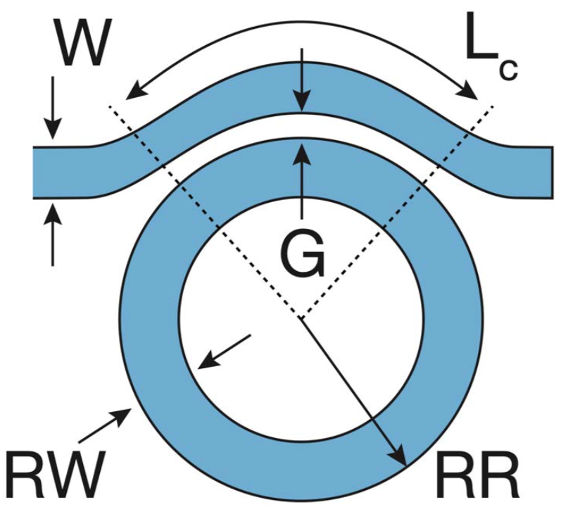
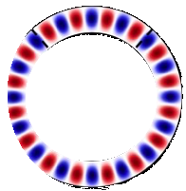

Frequency Combs
`
`
`

Slide 12
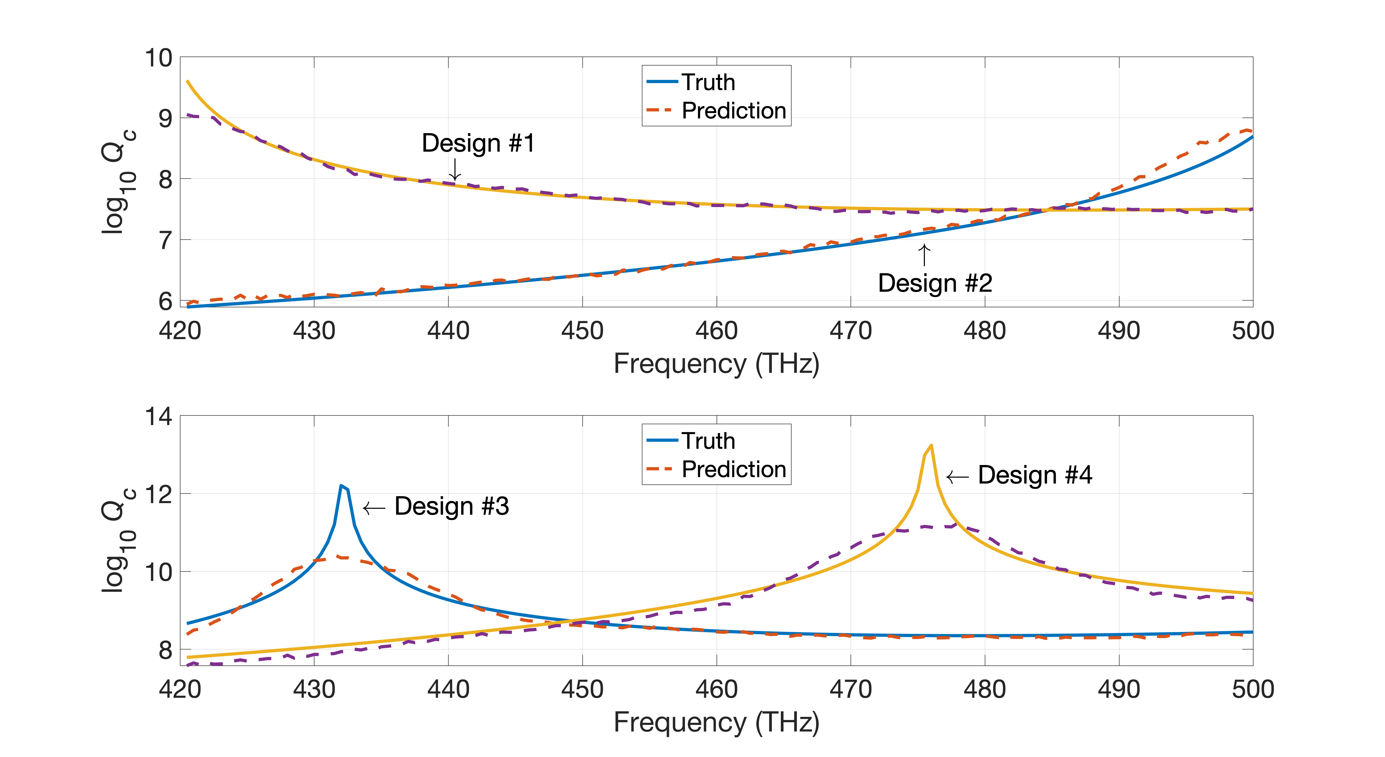
Spectrum Prediction with Attention
Accuracy: 90 %
Soroush et al., to appear in ACS Photonics

Slide 13
Thank You!
Ergun Simsek
simsek@umbc.edu
https://www.csee.umbc.edu/~simsek/

